Slide 1
Functions and Logical Flow
Animal Movement Modelling, Fall 2016

Slide 2
Writing A Function
Function Variable:
Stores function, used to make function call
eg. addition(3, 22)
function is a function for making functions!
input variables: required when calling function
Internal variable
Determines function output
subtract <- function(a, b) {
result <- a - b
return(result)
}

Slide 3
Logical Flow (If/Else Statements)
add <- function(a, b, c) {
if (is.numeric(c(a,b,c))) {
return(sum(a,b,c)
} else {
print(“Not all variables are numeric!”)
}
}
Must contain a logical (TRUE/FALSE) expression

Slide 4
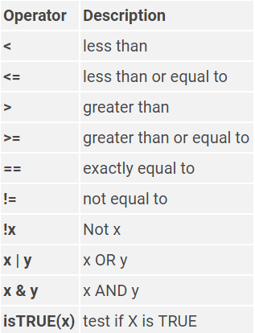
Logical Operators

